Slide 1
Space craft pose estimation using advanced algorithm
by :aly ashraf mohamad mosselhi
Supervised by:dr islam el shaarawy

Slide 2
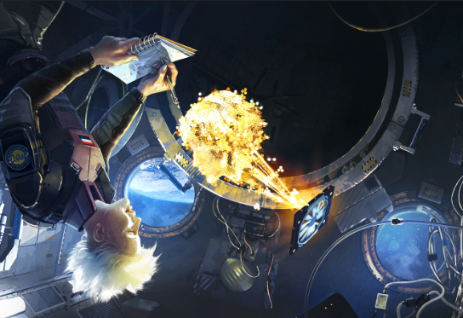
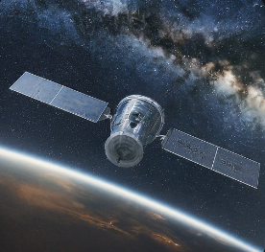
Introduction
In this presentation, we will explore the exciting potential of machine learning/computer vision for spacecraft pose estimation. We'll delve into the challenges of traditional methods and how machine learning offers a powerful alternative. We'll discuss various machine learning approaches and their advantages, showcasing how they can revolutionize spacecraft navigation and control.

Slide 3
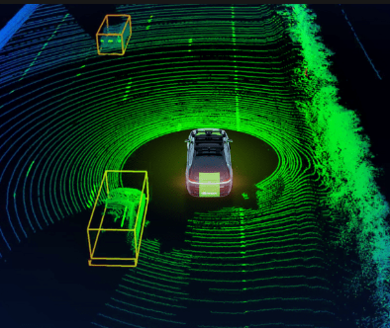
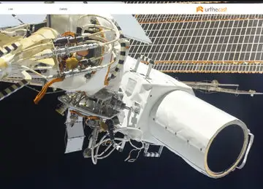
Background
Spacecraft pose estimation have been a thing for many years due to some missions like refueling or even returning an out of orbit satellite ,however they were done in traditional ways like
Depth camera
Lidars
Mounted gyroscopes

Slide 4
While they had their advantages such as
More accurate estimation
Immunity to occlusion
They also suffered from problems and drawbacks
Power consumption
High cost of maintenance

Slide 5

Motivation
While these are not very problematic on our planet they could be crucial due to the scarcity of resources in space and the limited power of spacecrafts,and if space go out of orbit then some of these methods are irrelevant.
My motivation is to explore the applicability of using normal monolithic camera + computer vision machine learning models to create a solution to these previous problems

Slide 6
Problem statement
While machine learning has some advantages over previous methods such as
Low complexity
Low power consumption
Easily upgradable and implemented
It is not far from perfect as it has some problems to overcome too like
Not immune to occlusion
If not careful model can get very big/have high complexity
Previous data is always needed beforehand

Slide 7
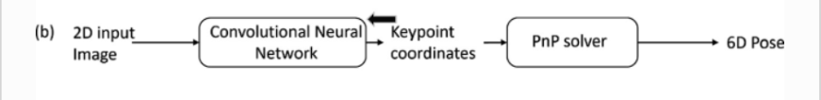
Related work(1) hybrid method
Research team (1) proposed a system architecture that is very good in terms which consists of
Regressing spaceship in the image
Regresses the key points of said spaceship
Get the pose by putting the key points in a pnp solver system

Slide 8
Related work (1) continued
While this approach got very high results,it suffered from a really big problem which was the complexity of the model. (78m parameters)

Slide 9
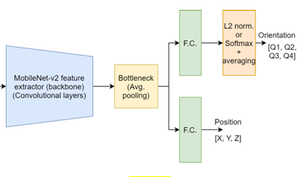
Related work (2) pure machine learning approach
Research team (2) proposed a purely machine learning model that focuses more on the model size rather than accuracy this model works purely of two steps.
Regress the translation of spaceship
Regress the orientation of the spaceship

Slide 10
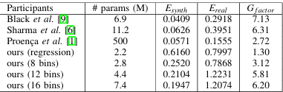
Related work(2) continued
Good in terms of size (from 2.2m to 7.8m parameters) scaled with the number of bins for orientation it suffers from a generalization problem and mediocre accuracy

Slide 11
Objective
Our project aims to create a model with with some characteristics by upgrading on research team(2) model
Robust model with low parameter size
Acceptable accuracy/score
Improve their generalization problem

Slide 12
Proposed solution
Luckily we got solutions to these problem by applying some computational games we can apply our objective we can do that by:
Using a light machine learning model to regress the pose
Using sufficient dataset for our training
Applying a number of data pre processing and augmentations

Slide 13
Dataset
Speaking of datasets our proposed dataset is the SPEED dataset by the european space agency
The dataset consists of 12k images of the TANGO satellite either generated by openGL or captured from space separated into two types of images
Real images
Synthetic images
And the real images are categorized as
Real test images
Real train/validation images

Slide 14
Dataset continued
The images come with two kind of labels
Label for translation which consists of the [x,y,z] coordinates of the Tango satellite
Label for the orientation which consists of the quaternions of the spaceship [q1,q2,q3,q4]
Frequently asked question(what is quaternions and what benefits over the cartesian rotation)
Quaternions are a rotation metric used over the cartesian in aerospace environment because it is more accurate in rotation results,more reliable due to its most important gimmick which is the avoidance of a problem called the gimbal lock singularity in which when all the metrics lock onto the X axis the cartesian metrics gets confused and gets into a locked position where the values of the rotation is garbage

Slide 15
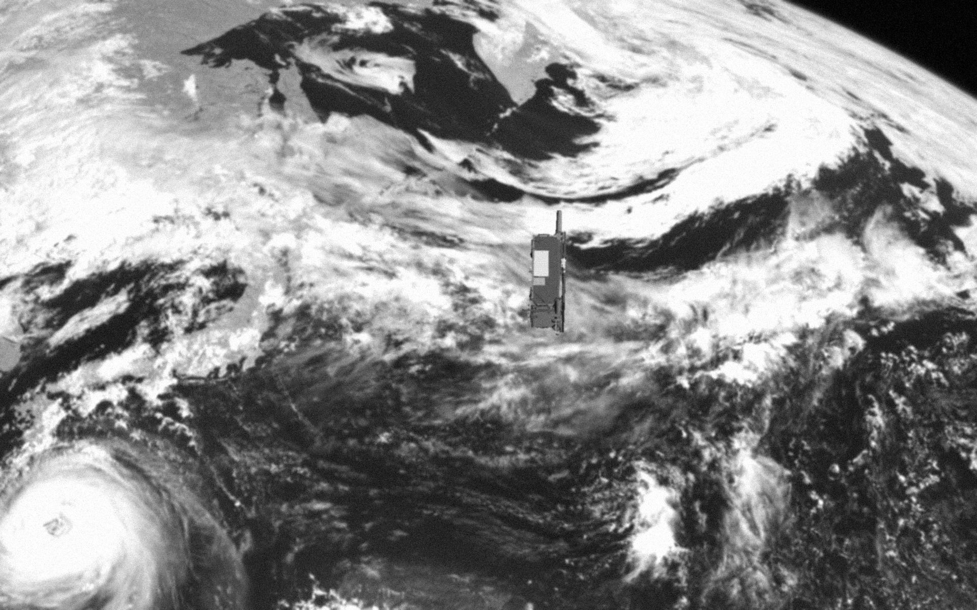
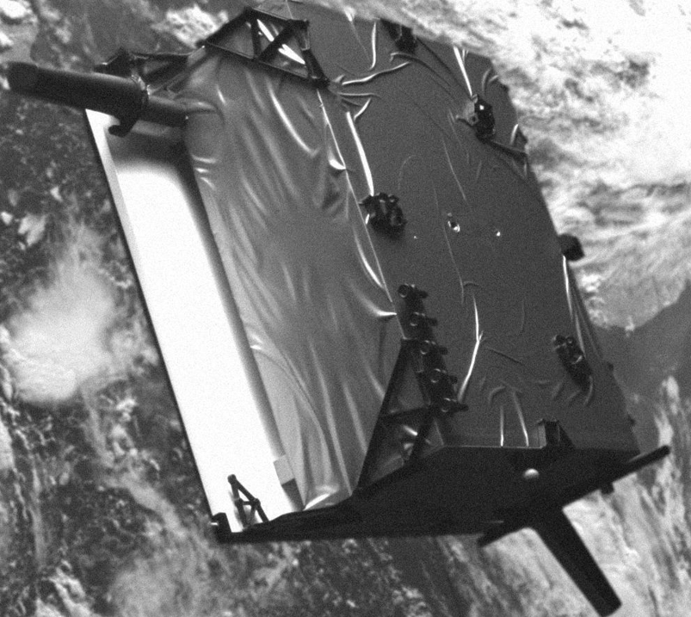
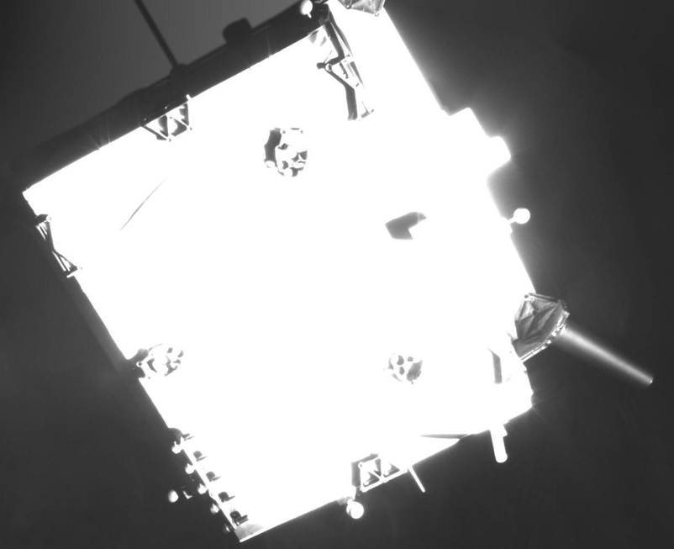
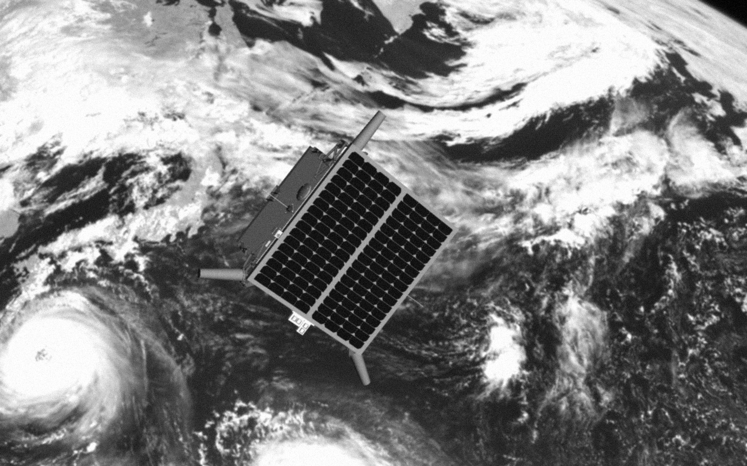
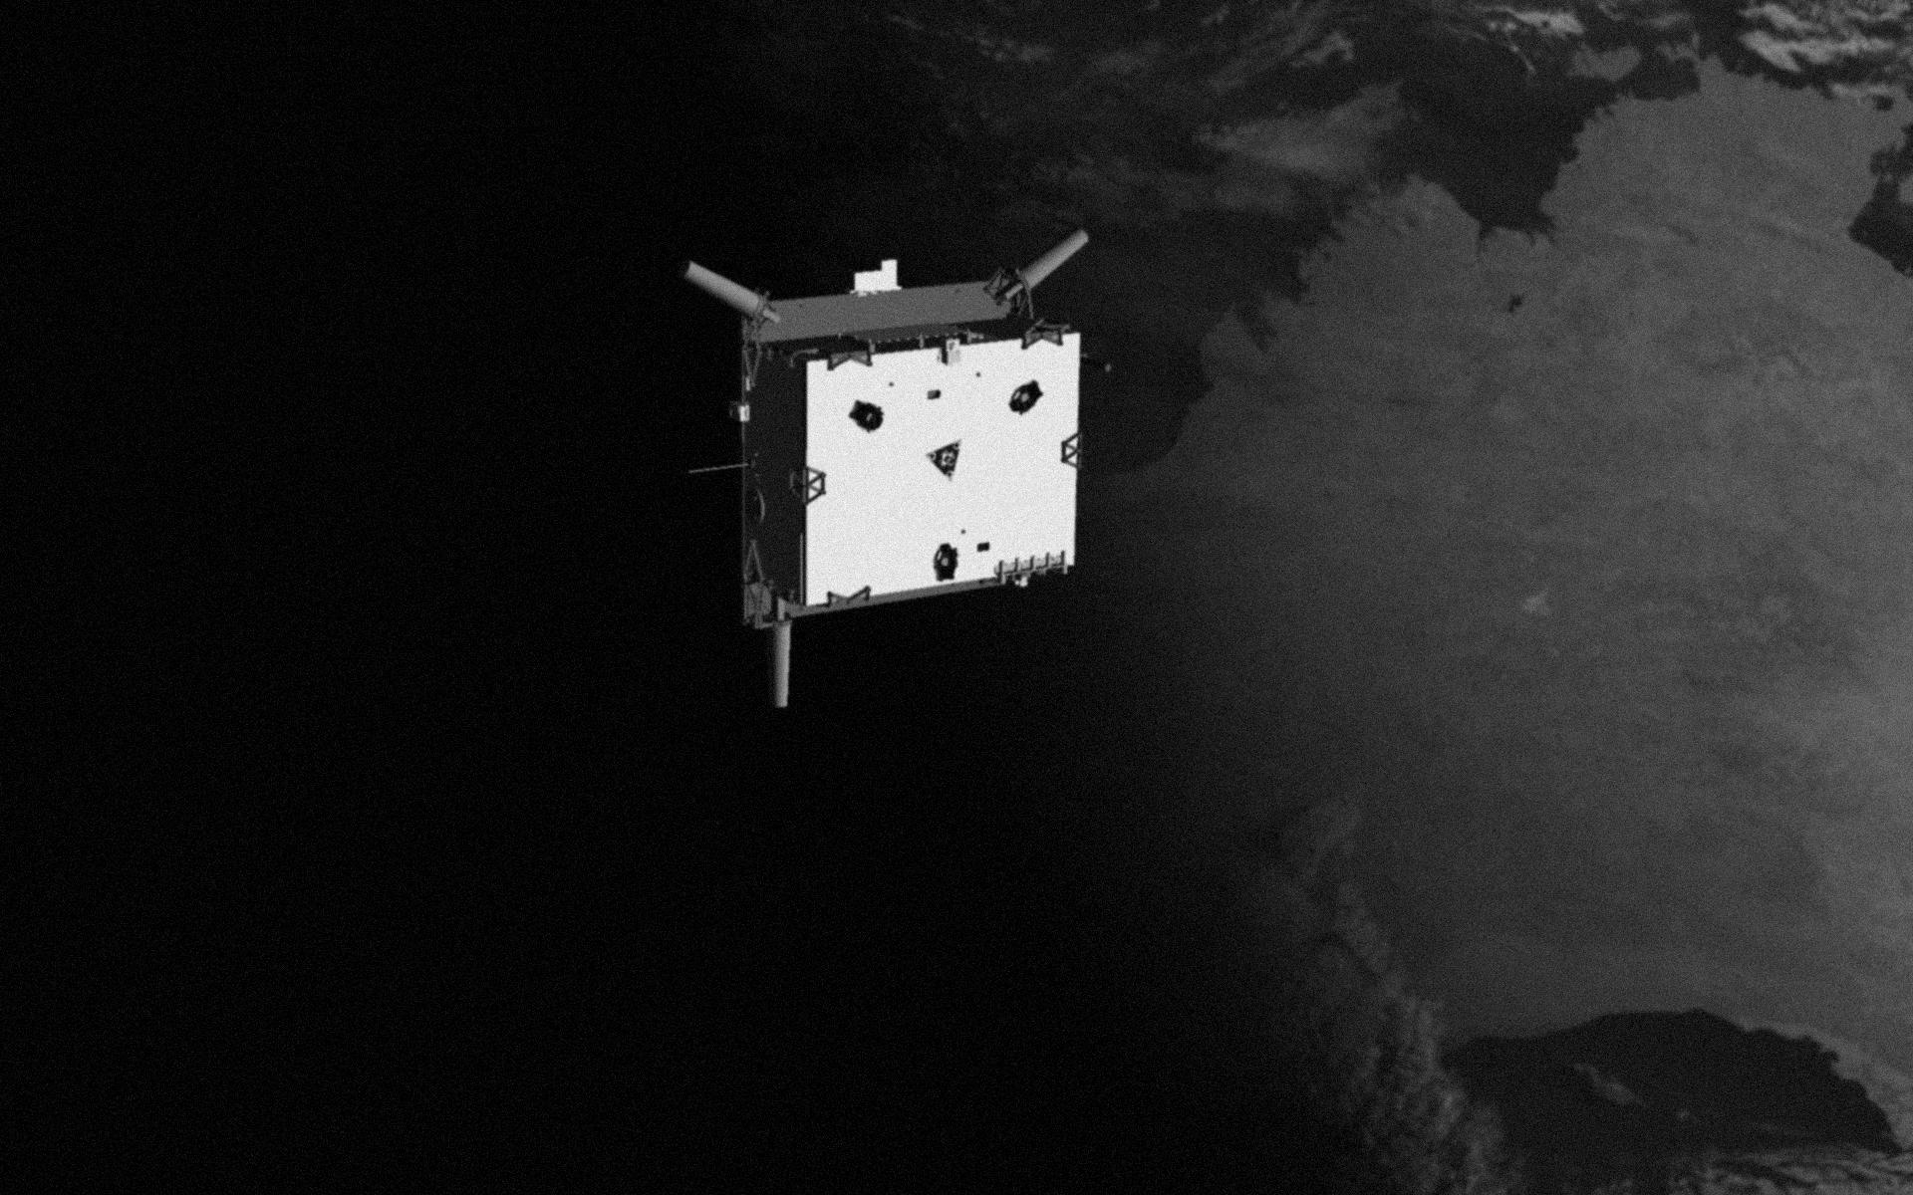
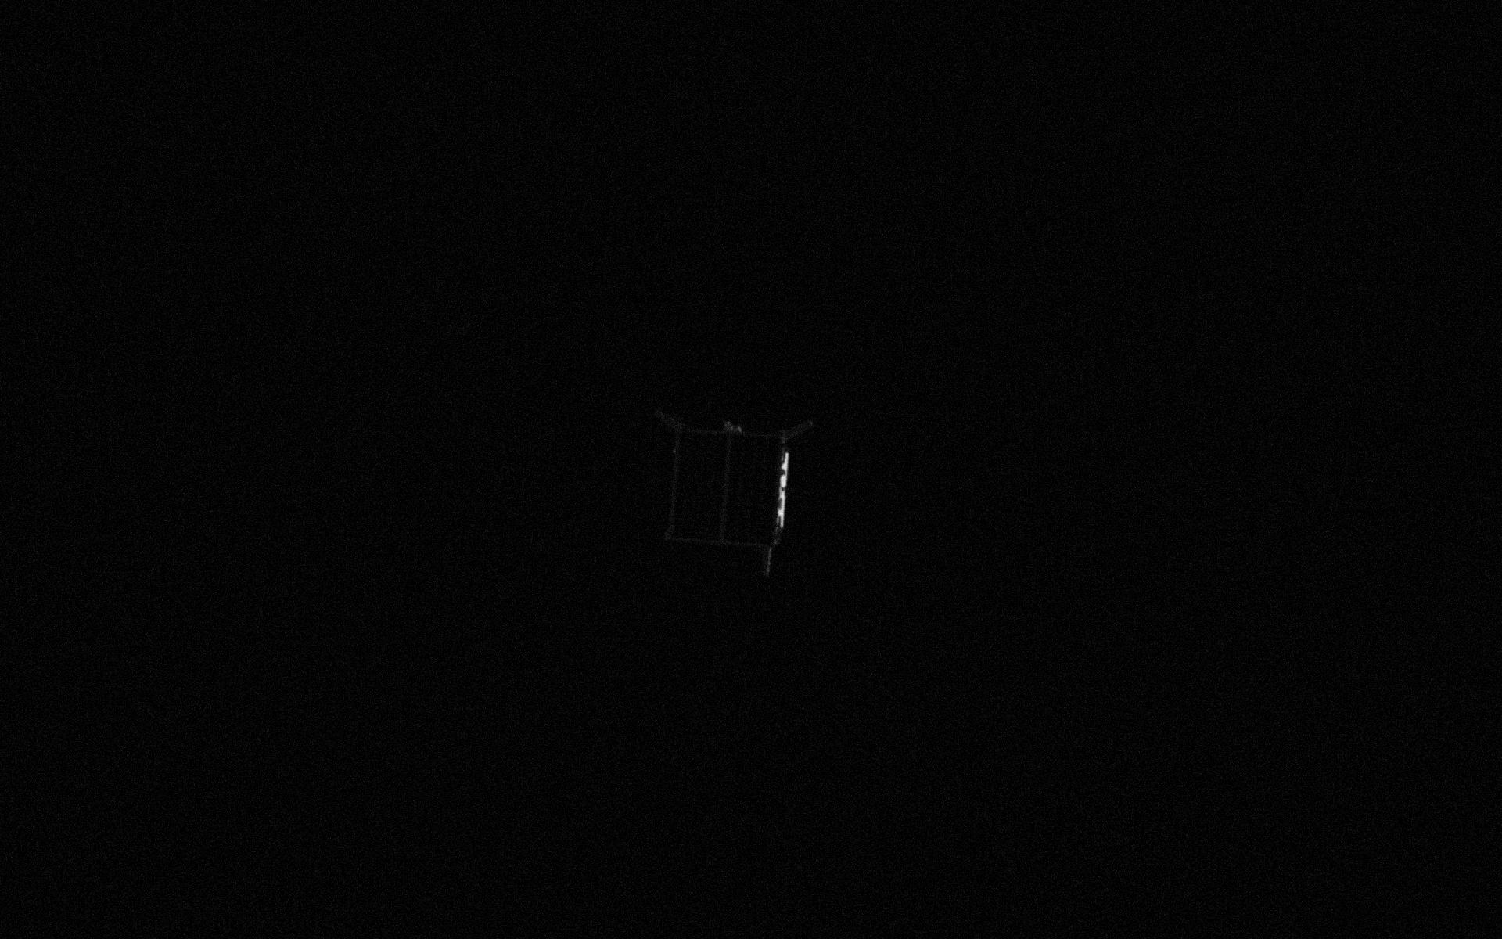
Sample of the dataset

Slide 16
methodology/algorithm
As previously mentioned in the objective department we have a few tasks to complete to call this project a success therefore we used a bunch of algorithms and filters to make our objective happen the most important aspect of these algorithms are
Efficentnet as the backbone
Poisson noise to help generalization/avoid overfitting
CLAHE histogram method to increase the contrast in images resulting in better feature extraction for regressing the pose
Image resizing to make the number of parameters even lower

Slide 17
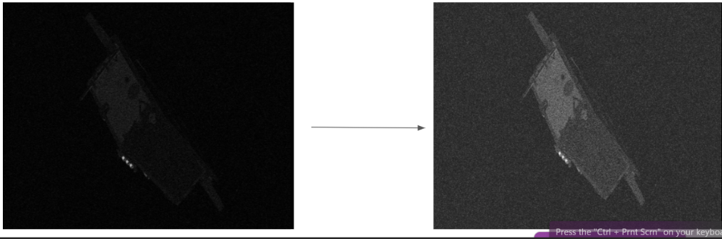
Figure of Clahe for demonstration
This histogram is added to all images to help it see hidden features when regressing the pose

Slide 18
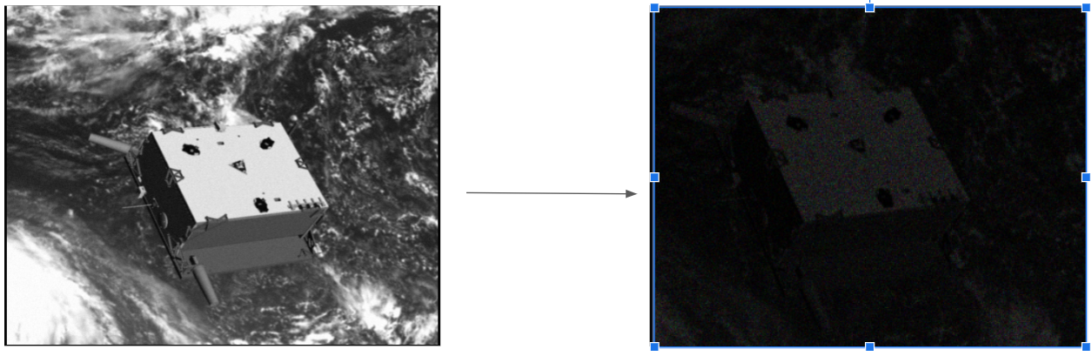
Figure for poisson noise demonstration
This noise is added to some of the images so the model does not overfit
And it is the most common noise in space environment

Slide 19
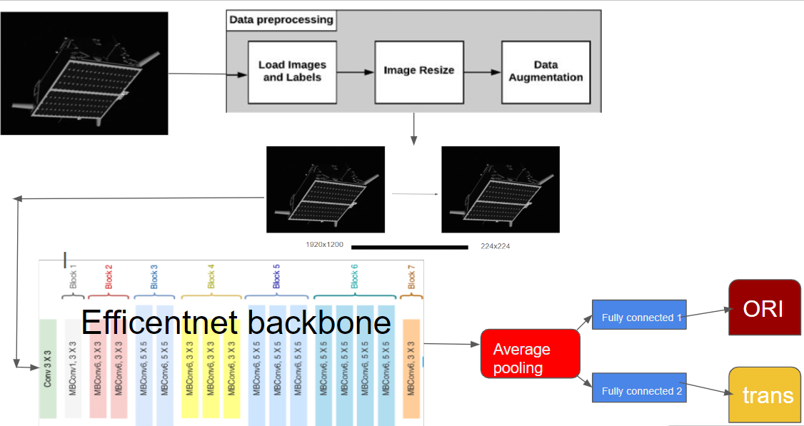
System architecture

Slide 20
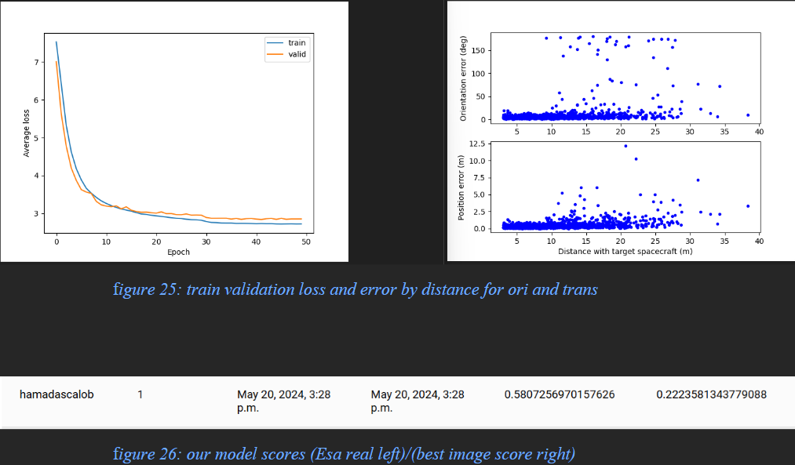
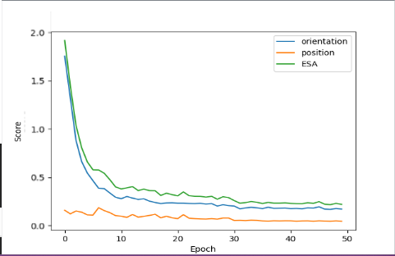
Results
Our method proved promising in terms of score,generalization and size of model.
Here are our results

Slide 21
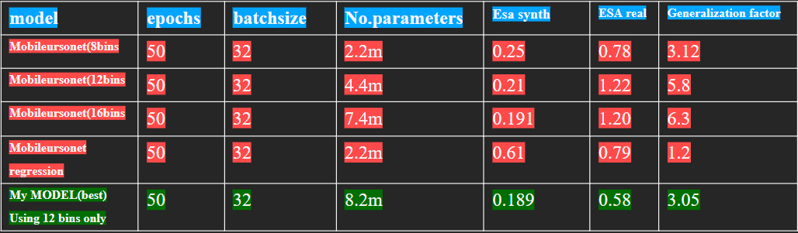
Comparative result

Slide 22
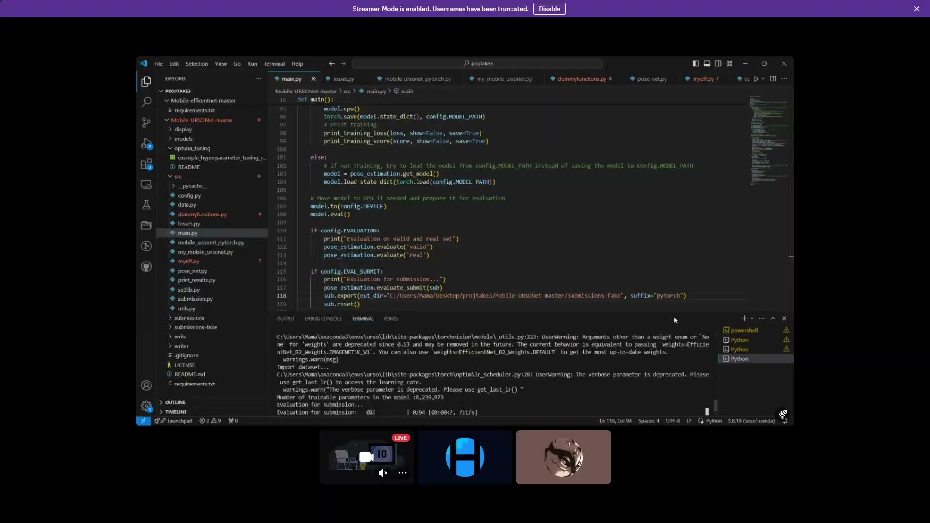

Slide 23
Conclusion
In Conclusion we proved that a machine learning approach is applicable in this problem and it can provide some competitive edge over the traditional methods such as speed,less complexity and last but not least less cost.
While it provided these advantages they could also come at some disadvantages such as less accuracy,vulnerability to occlusion and if used wrong it could nullify its advantages.

Slide 24
Future work
While our model is good compared to the original MobileUrsonet,it still has room for improvement in
Usage of a more robust backbone can provide better model size
More advanced augmentation method can provide more generalization
Usage of the more advanced dataset SPEED+ may provide better results over all
Testing on an embedded environment like raspberry pi could further prove the usefulness of the model

Slide 25
References
-J. Posso, G. Bois and Y. Savaria, "Mobile-URSONet: an Embeddable Neural Network for Onboard Spacecraft Pose Estimation," 2022 IEEE International Symposium on Circuits and Systems (ISCAS), Austin, TX, USA, 2022, pp. 794-798, Doi: 10.1109/ISCAS48785.2022.9937721.
-Legrand, A., Detry, R., De Vleeschouwer, C. (2023). End-to-end Neural Estimation of Spacecraft Pose with Intermediate Detection of Keypoints. In: Karlinsky, L., Michaeli, T., Nishino, K. (eds) Computer Vision – ECCV 2022 Workshops. ECCV 2022. Lecture Notes in Computer Science, vol 13801. Springer, Cham. https://doi.org/10.1007/978-3-031-25056-9_11

